Slide 1
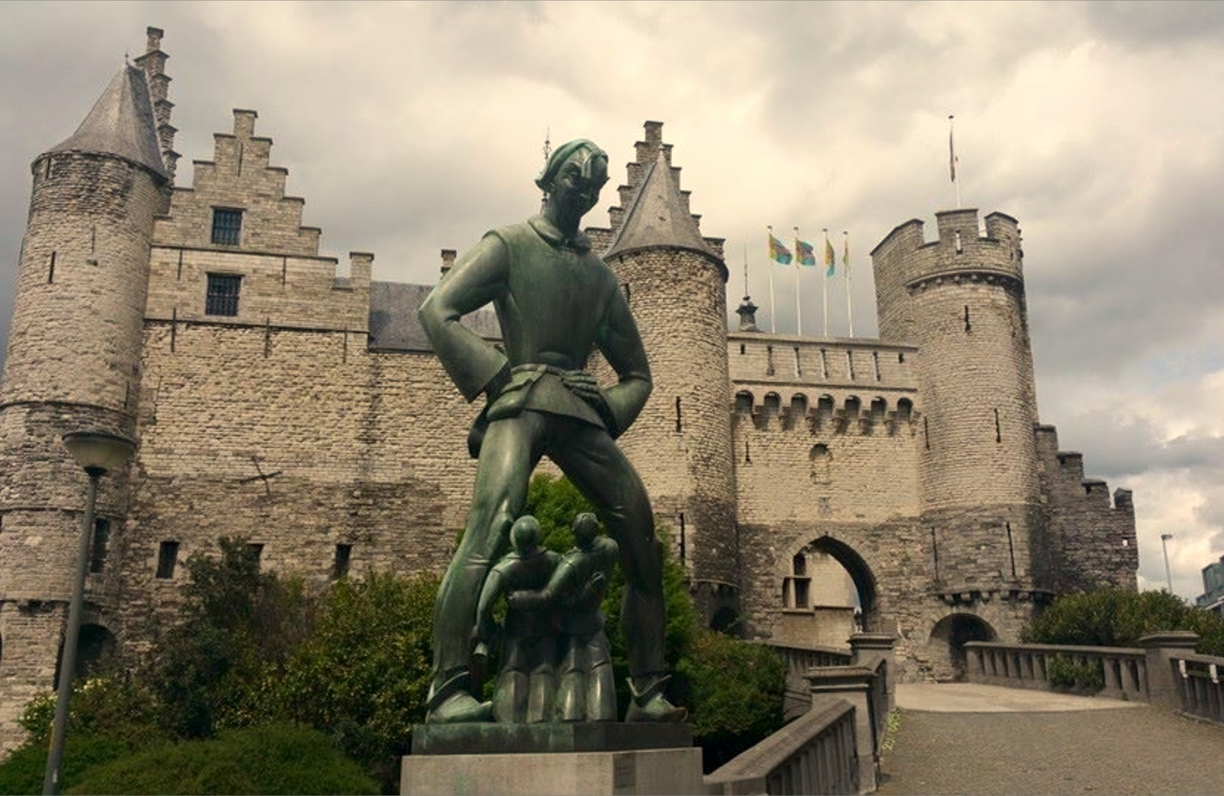

The A-team
Nami Shah • Sari Van Swalm • Sebastien Trifiletti
Theo Juif • Jakub Kowalczyk • Michał Beczkowski

Slide 2
CONCEPT
Get home safe!
Start at Het Steen
4 Parts
Visit something CULTURAL
Go to a RESTAURANT
Go to a PUB
Vlaaikensgang

Slide 3

DESIGN

Slide 4
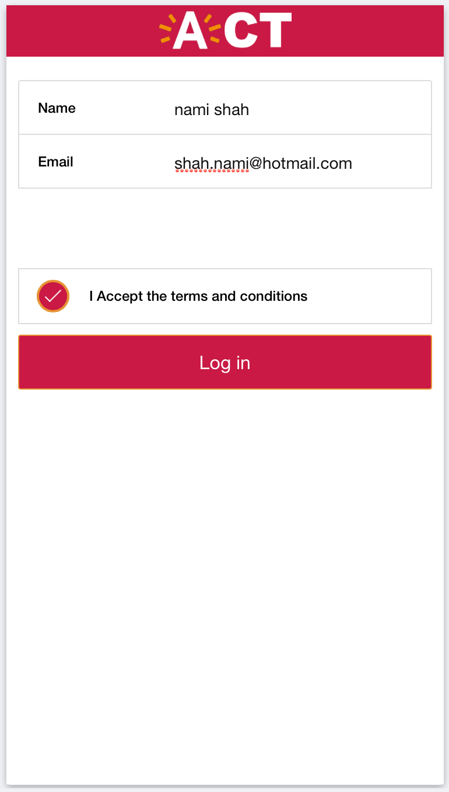

Slide 5
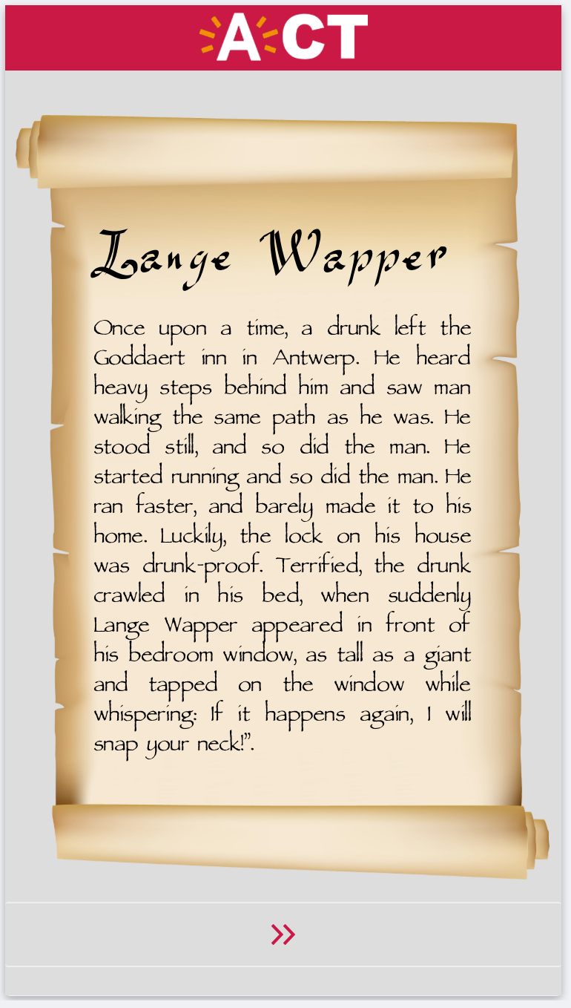

Slide 6
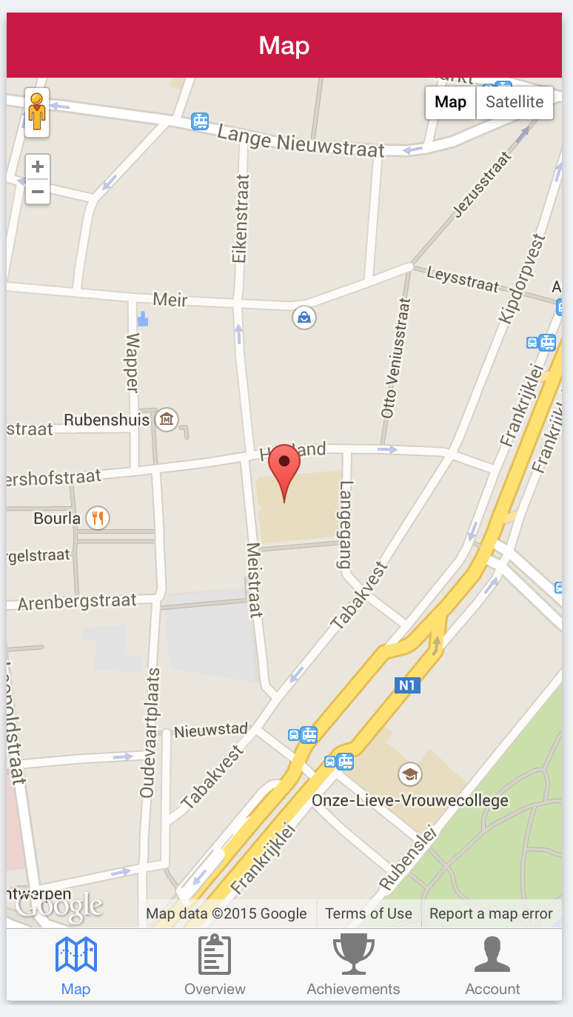

Slide 7
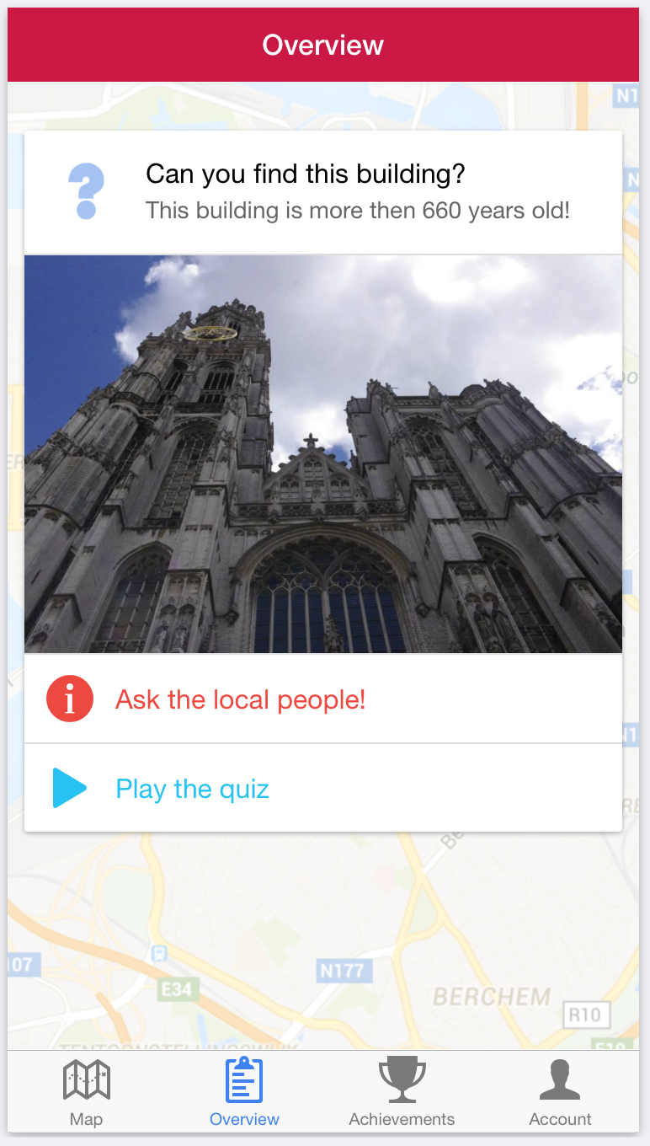

Slide 8
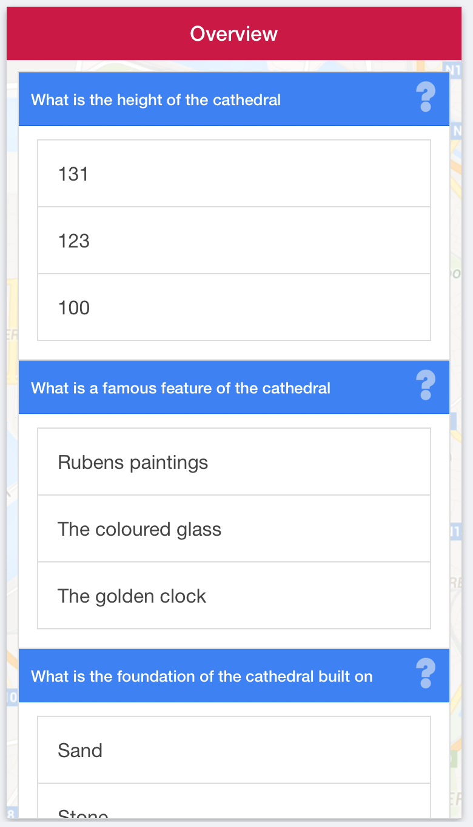

Slide 9
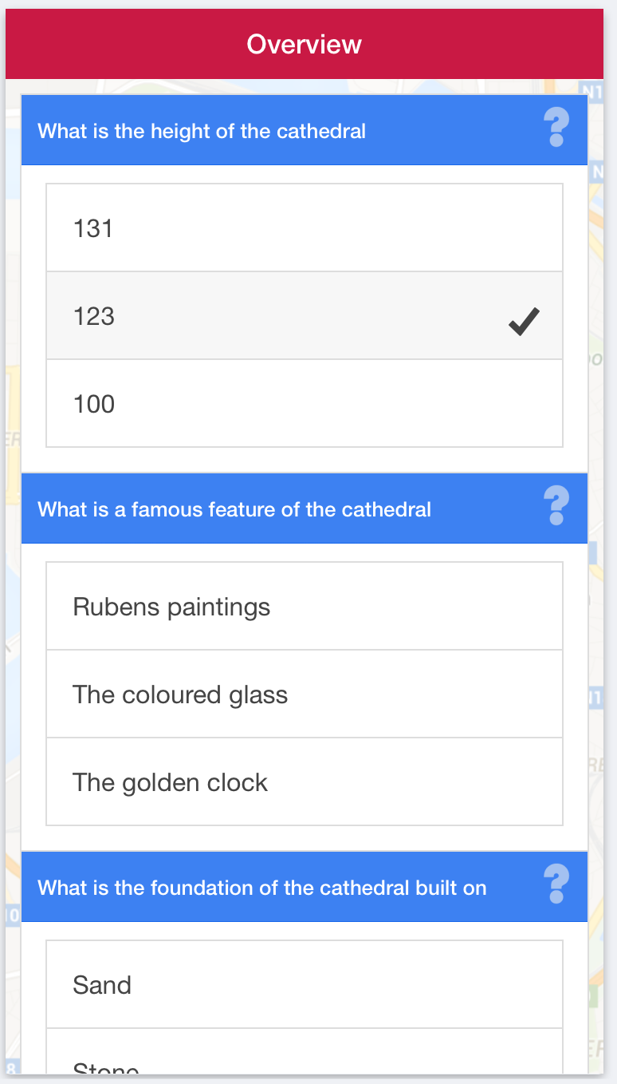

Slide 10
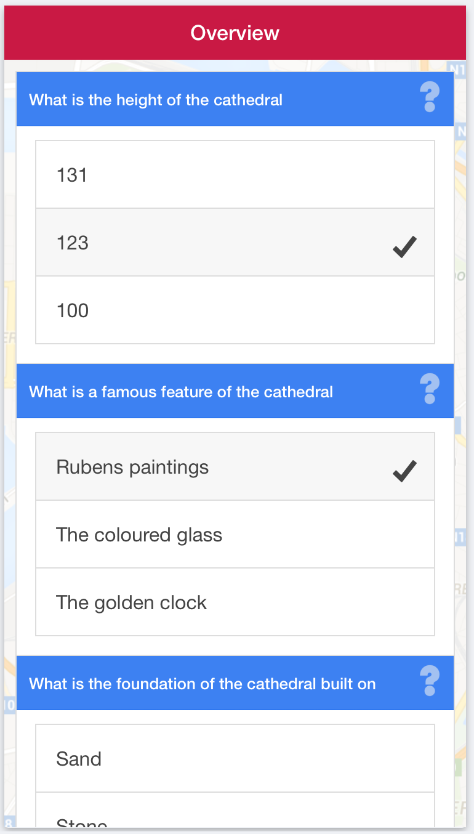

Slide 11
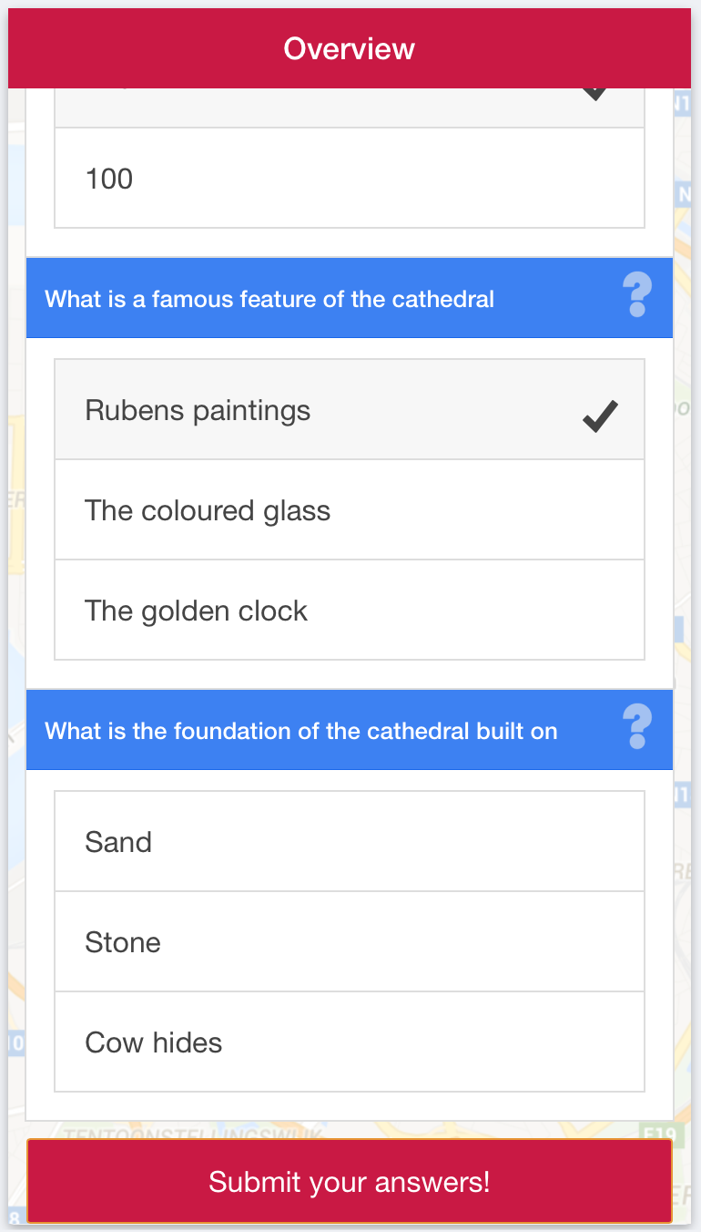

Slide 12
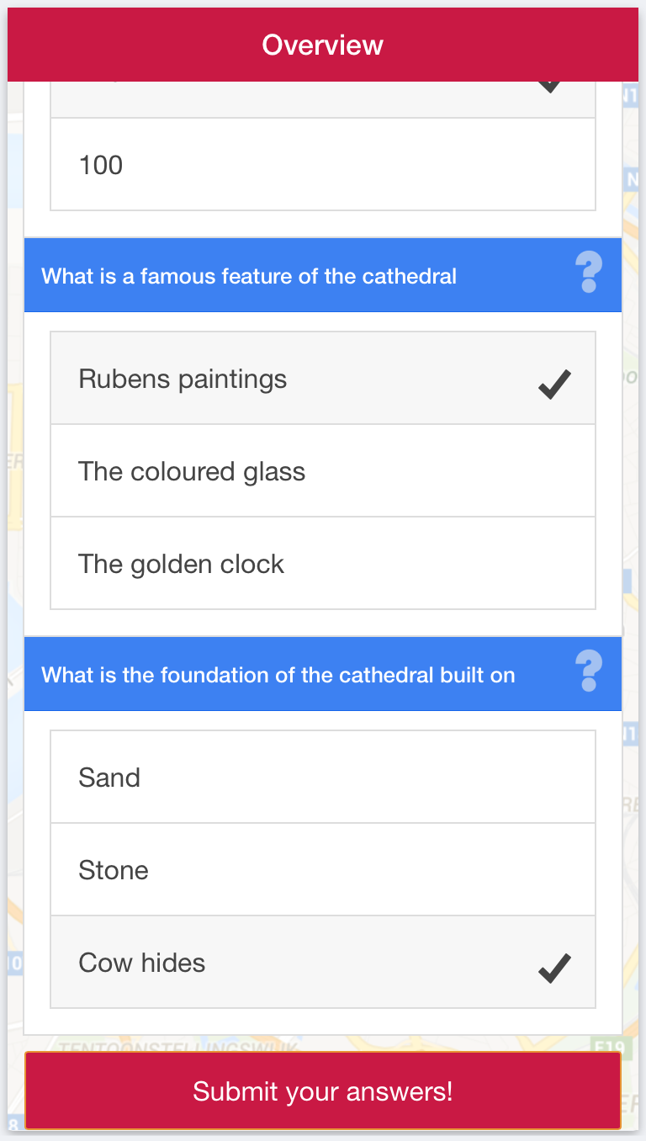

Slide 13
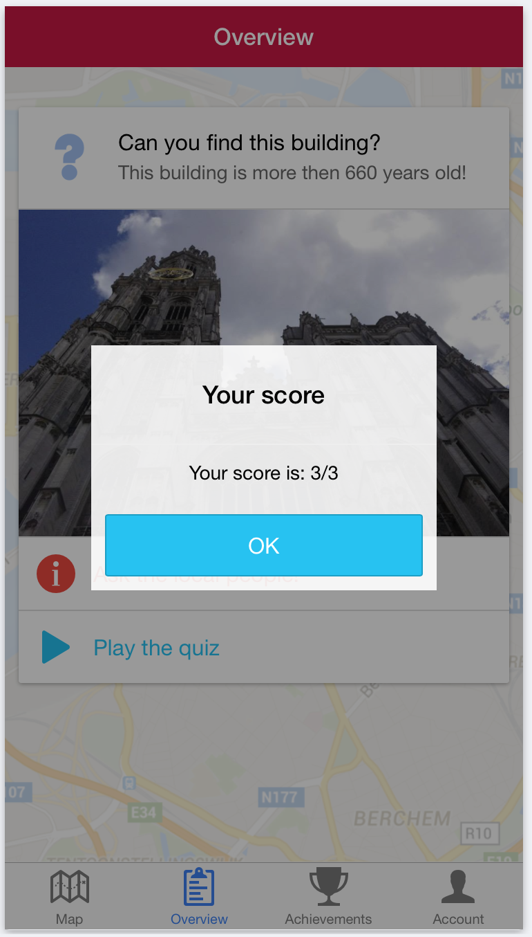

Slide 14
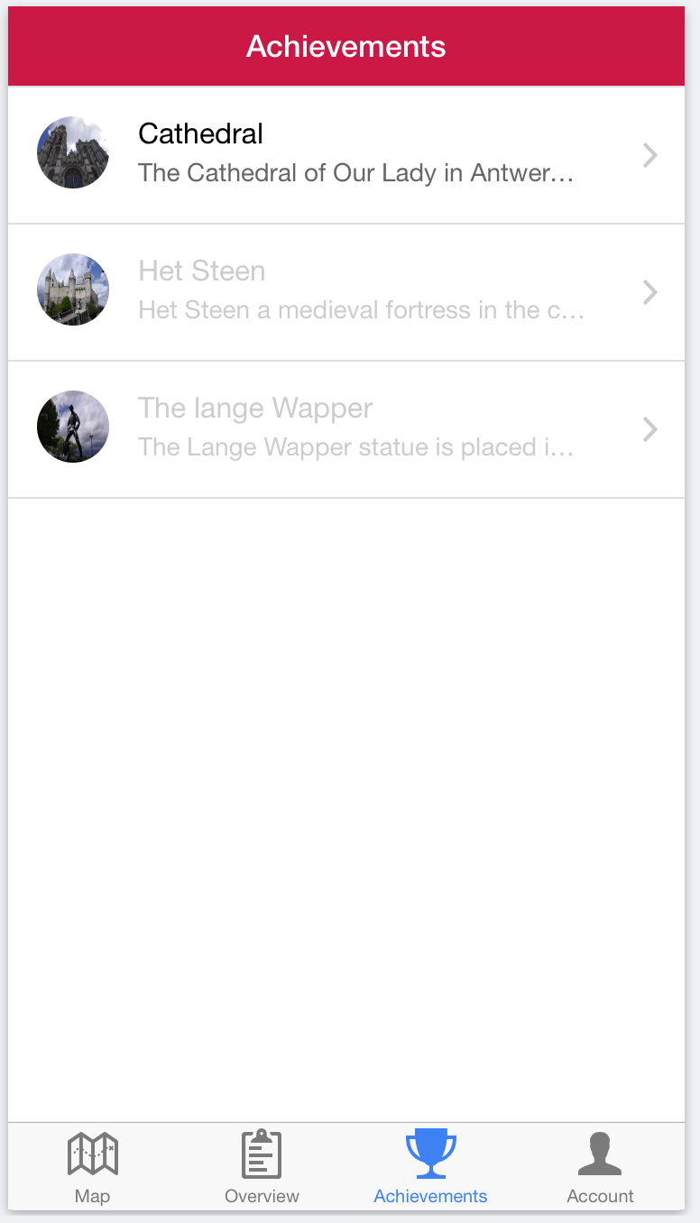

Slide 15
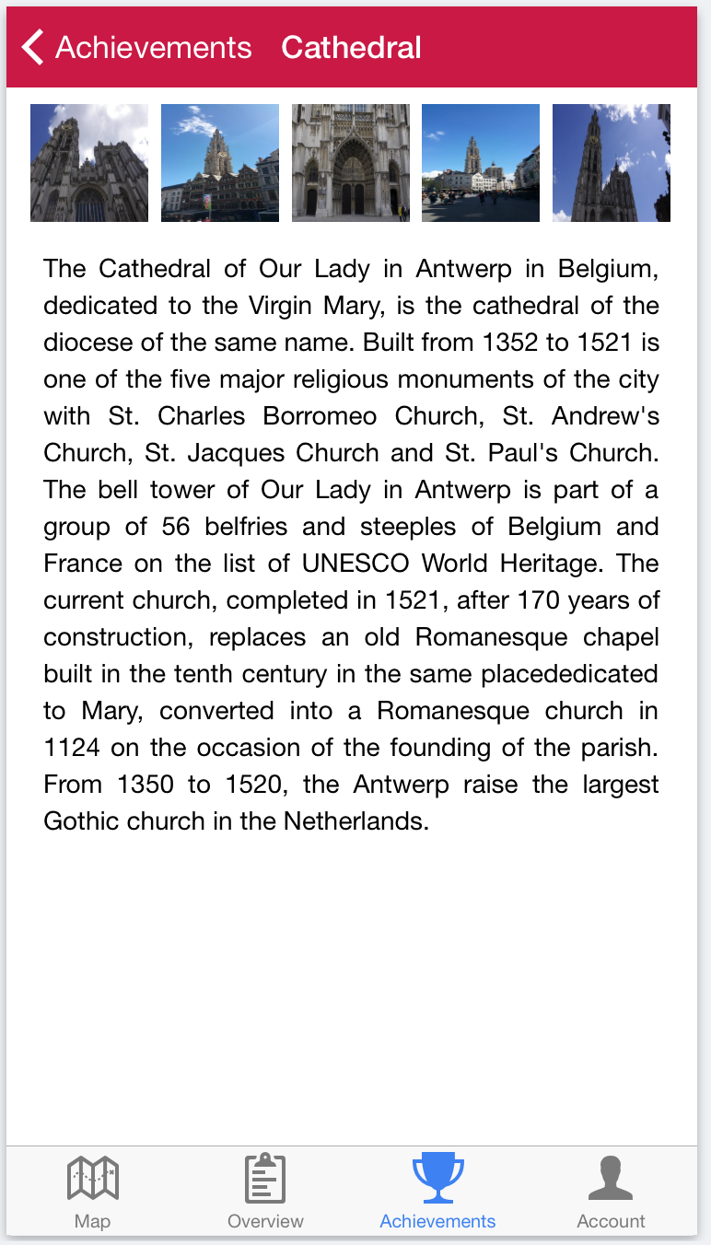

Slide 16
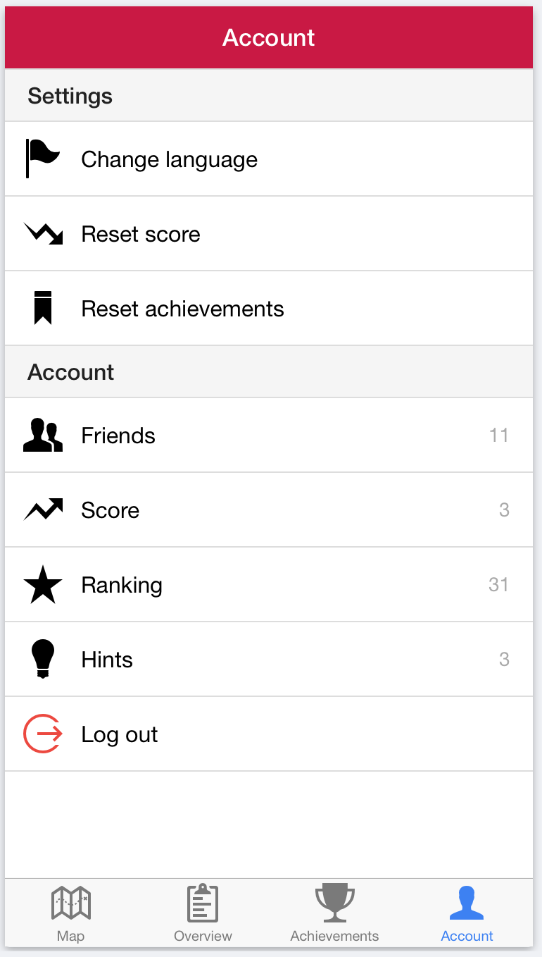

Slide 17
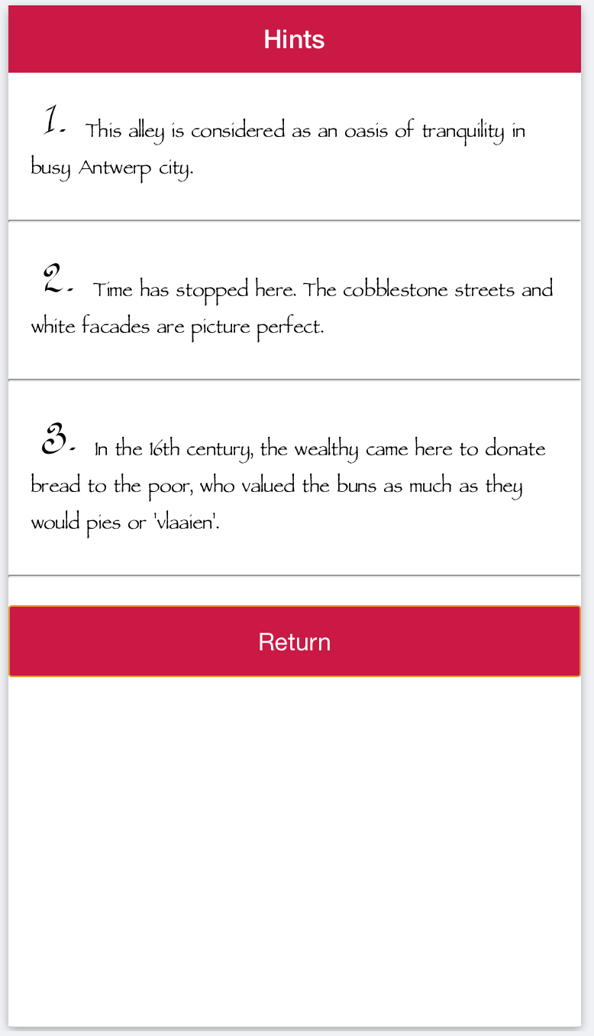

Slide 18
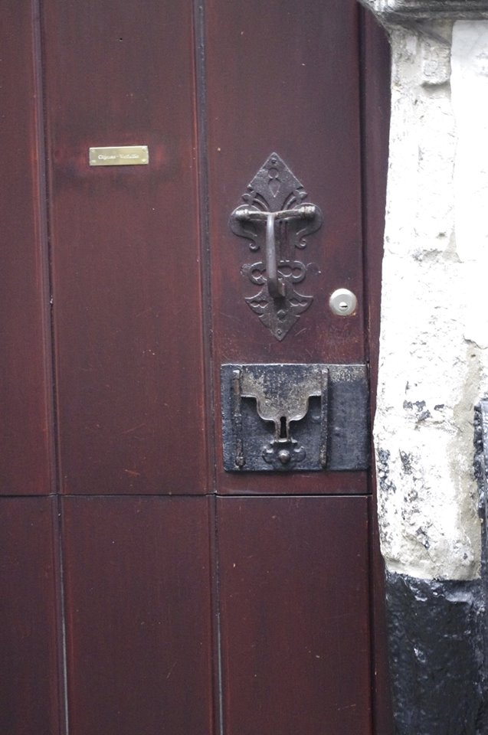

Slide 19
TARGET
18-30 : Result of the focus group
Customize
Social networks, sharing
Looking for promotion and trendy places

Slide 20
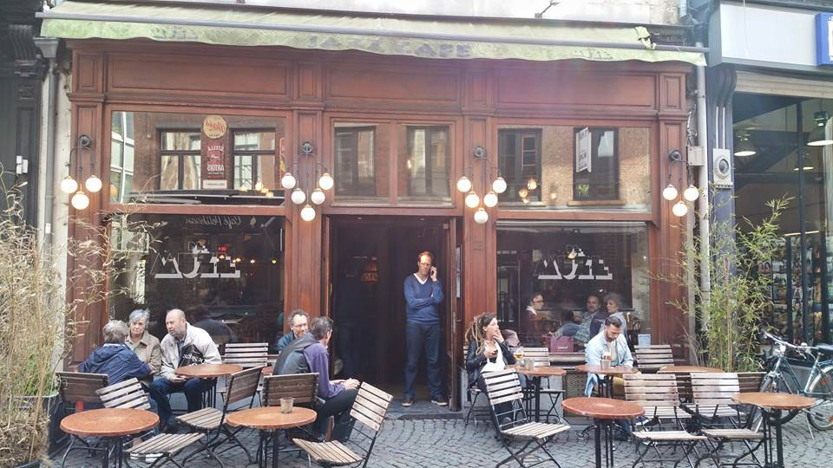
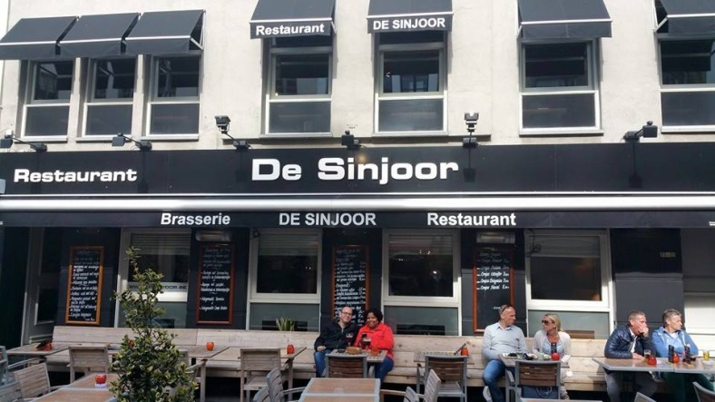
PROMOTION
5 % in the bar & at the restaurant
=> The benefits for them?
Expand their customer base
Advertising on Social Media by the players

Slide 21
FINANCIAL
Pop-up by geolocalisation
Free application
If it works, make restaurants and pubs pay to be in our database
City of Antwerp promotes 1 app per year

Slide 22

FUTURE?
Spread our application
New special places in Antwerp

Slide 23

Thank for your attention!

